Slide 1

Quantification of Electrogram Signal Quality
By: Cole Kappel

Slide 2

The Quality Program
Calculates the dv/dt from the voltage vs time data
Calculates the period of electrograms using autocorrelation
3 different methods for calculating quality.
The results looking at positive dv/dt are saved as “Max Method” (MAM) results.
The results looking at negative dv/dt are saved as “Min Method” (MIM) results.
The third method is the “Absolute Max Method” (AMM) which compares the MAM quality to MIM quality for the trace and whichever value is greater is simply the AMM quality
Quality ranges from 0 to 1 for all methods.

Slide 3
To better understand the program we can consider this electrogram
Shown here is the voltage vs time data

Slide 4
|
lag = 0 ms
|
lag = 190 ms
The program uses auto correlation to detect the correlation of the signal with a time lagged version of itself
The program calculates the period of the trace as the lag value corresponding to the maximum point next to the absolute maximum point on the autocorrelation plot. In this case this value is 190 ms

Slide 5
|
|
|
|
|
|
|
|
|
|
|
|
|
|
|
|
|
|
|
|
|
|
|
|
|
|
|
|
|
|
|
|
|
|
|
|
|
|
|
|
|
|
|
|
|
|
|
|
|
|
|
|
|
|
|
|
|
|
|
|
|
|
|
|
|
|
|
|
|
|
|
|
|
|
|
|
|
|
|
|
|
|
|
|
|
|
|
|
|
|
The trace is then broken up into period sized (190 ms) intervals

Slide 6
Example: “Max Method (MAM)”
1
3
2
4
5
MAM array value = 0.7032
The program then looks at the dv/dt plot for the first interval of the trace
For this trace the value added to the MAM array would be (point 1 – average (point 2-5))/(point 1)
This type of calculation happens for every period sized interval on the trace and quality for the trace is calculated as the mean of the MAM array. For a 60 second trace with a period of 200ms, the program would look at 300 intervals.

Slide 7
Example: “Min. Method (MIM)”
1
2
3
4
5
MIM array value = 0.9259
The program then looks at the same interval but now with –dv/dt to take into consideration maximum -dv/dt points.
The value added to the MIM array for this trace would be (point 1 – average(point 2-3))/(point 1)
Points 4 and 5 are not considered because they correspond to positive dv/dt values.
The MIM quality for the trace is the mean of the MIM array

Slide 8
Visual
|
|
|
|
|
|
|
|
|
|
|
|
|
|
|
|
|
|
|
|
|
|
|
|
|
|
|
|
|
|
|
|
|
|
|
|
|
|
|
|
|
|
|
|
|
|
|
|
|
|
|
|
|
|
|
|
|
|
|
|
|
|
|
|
|
|
|
|
|
|
|
|
|
|
|
|
|
|
|
|
|
|
|
|
|
|
|
|
|
|
|
|
|
|
|
|
|
|
|
|
MAM Q. = mean(MAM Array) = 0.7193
MAM Array
0.7032
0.7335
0.7434
0.6997
0.5424
…
MIM Array
0.9259
0.9567
0.9950
0.9357
0.9254
MIM Q. = mean(MIM Array) = 0.9518

Slide 9
Example: “Abs. Max Method (AMM)”
MAM quality value = 0.7193
v.s.
MIM quality array value = 0.9518
Shown here is 1900ms of data but the quality for this trace is calculated by looking at about 58,000 ms of data
Since the MAM value for the trace is 0.7193 and the MIM value for the trace is 0.9518, the AMM quality for this trace is 0.9518 since 0.9518 > 0.7193.

Slide 10
Examples of High and Low Quality Traces
S-0022 F4
Fig. 1
v
t
High
AMM = 0.9528
S-0033 A1
Fig. 2
v
t
Low
AMM = 0.5691
S-0013 A1
Fig. 3
v
t
High
AMM = 0.9494

Slide 11

Quality Results for 19 AF Terminated Patients and 20 Non Terminated Patients

Slide 12
(AMM)
2 tailed T-test: p = 0.0056
Mean Term Quality:
0.715037472
Mean Non-Term Quality:
0.668824123

Slide 13
(MAM)
2 tailed T-test: p = 0.0087
Mean Term Quality:
0.700897573
Mean Non-Term Quality:
0.659096529

Slide 14
(MIM)
2 tailed T-test: p = 0.0022
Mean Term Quality:
0.623784843
Mean Non-Term Quality:
0.577530997

Slide 15
High Quality Color Map:
Average Quality: 0.7911

Slide 16
Low Quality Color Map:
Average Quality: 0.6136

Slide 17

ROC Curves

Slide 18
(AMM)
AUC: 0.7737
Optimal Operating Point (FPR,TPR): (0.200, 0.7368)

Slide 19
(MAM)
AUC: 0.7395
Optimal Operating Point (FPR,TPR): 0.4000, 0.8947

Slide 20
(MIM)
AUC: 0.7868
Optimal Operating Point (FPR,TPR): (0.3500, 0.8421)

Slide 21
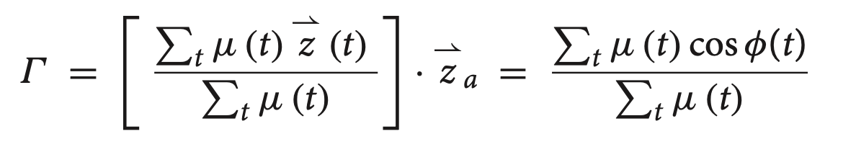
The Kulkik Method
Fidelity
( )

Slide 22

Kulkik Quality Results for 19 AF Terminated Patients and 20 Non Terminated Patients

Slide 23
2 tailed T-test: p = 0.6861
Mean Term Quality:
0.5050
Mean Non-Term Quality:
0.4983

Slide 24
2 tailed T-test: p = 0.7363
Mean Term Quality:
0.6084
Mean Non-Term Quality:
0.6164

